Slide 1
Cannula for Grasping and Setting Lead with Needle
Neuralink, US 2023/0310028 A1, Published 10/5/2023
6/19/2024

Slide 2
Background
Brain-machine interfaces (BMIs) require fine-scale communication (at the neuron level)
Advanced BMIs require increasing # of neurons by many orders of magnitude → multiple lead-bearing electrodes
Implanting electrodes requires extreme precision – micron/sub-micron scale
Each lead should be held in place for accurate implantation
Equipment for guiding leads must be cleanly detached from needle after implantation

Slide 3
Outline
Goal: Describe a system for a lead, needle, and cannula sized and shaped for ease of needle threading and positioning (e.g., implantation into biological tissue)
Embodiments:
About the System
Cannula, Needle, and Lead in 1st + 2nd Configurations
Cannula, Needle, and Lead
Cannula Photographs
Close-Up Views of Cannula
Lead with Expanded Region
Needle with Ledge
Close-Up Views of Lead and Needle
Example Geometry of Lead and Needle
Engagement + Implantation Techniques:
Needle, Lead and Cannula
Lead Engaged with Needle and Cannula
Multiple Leads Disposed for Implantation
Apparatus for Implantation and Engagement of Lead
Close-Up View of Apparatus for Implantation and Engagement of Lead
Flowchart for Engagement & Implantation of Lead
Computer System

Slide 4
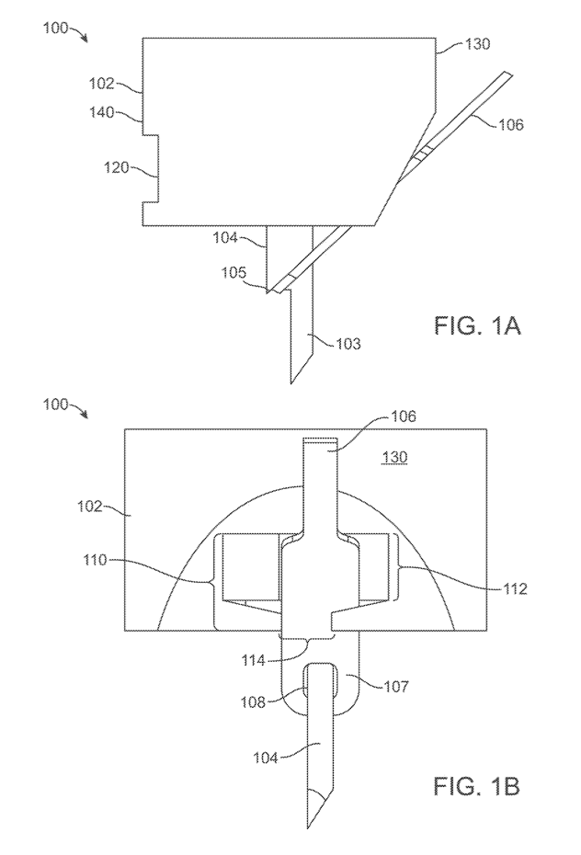

Cannula, Needle, and Lead in 1st Configuration
1st Config: Needle and lead held in place via respective geometry
Lead
1st Side
Cannula
1st Side
Cannula
2nd Side
Lead
Biocompatible (e.g., polyimide)
Include conductive material (e.g., thin gold trace) deposited in polyimide substrate to transmit information
Up to 3 layers of insulation, 2 layers of conductor
Include many wires with small electrodes
Exit Gate
Indentation
(allows opening to prevent needle from colliding to back wall of cannula)
Aperture
Needle
Slot
Expanded Region
Ledge
Opening
Needle
Side View
Front View

Slide 5
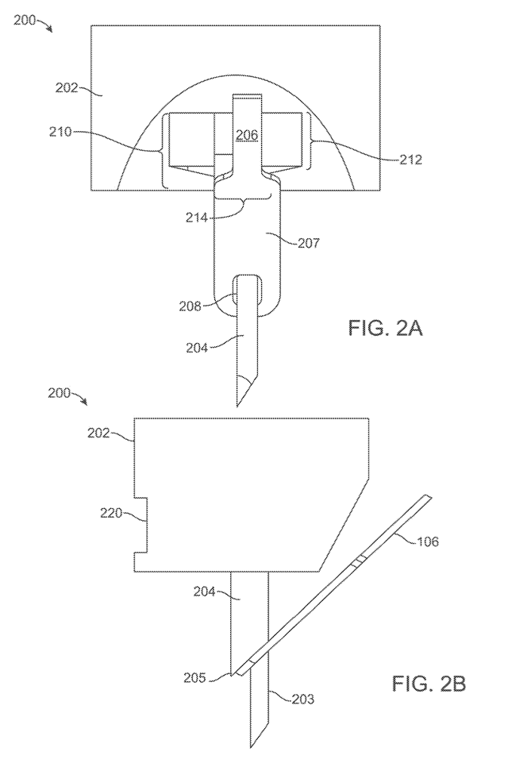


Cannula, Needle, and Lead in 2nd Configuration
2nd Config: Needle and lead positioned lower wrt cannula
Lead
Cannula
Cannula
Lead
Needle
Needle
Front View
Side View

Slide 6
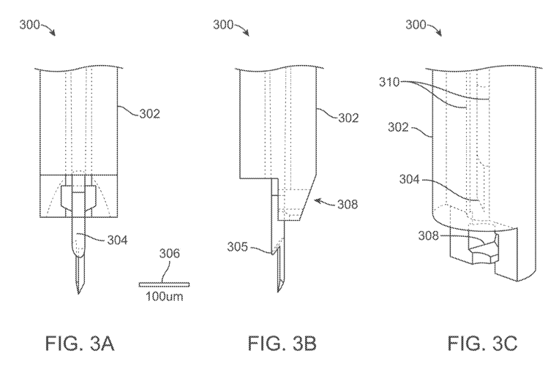
Cannula, Needle, and Lead
Cylindrical cavity
Cannula
Cannula
Needle
Exit gate
Scale
Needle
Exit gate
(holds lead in place via its geometry)
Ledge
Front View
Side View
Cross-sectional View

Slide 7
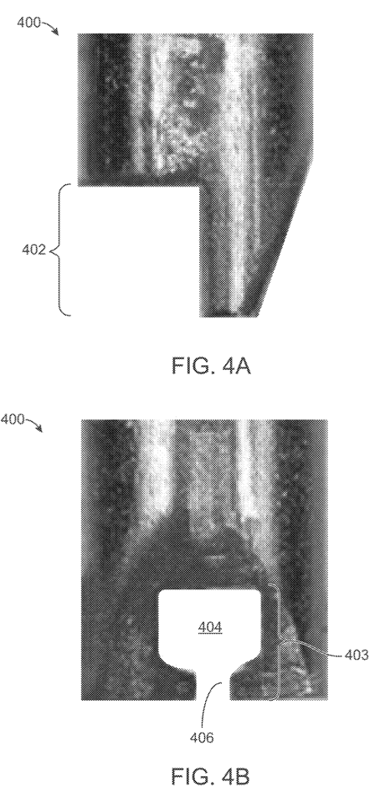
Photographs of Cannula
Aperture
Indentation
Exit gate
Slot
Side View
Front View

Slide 8
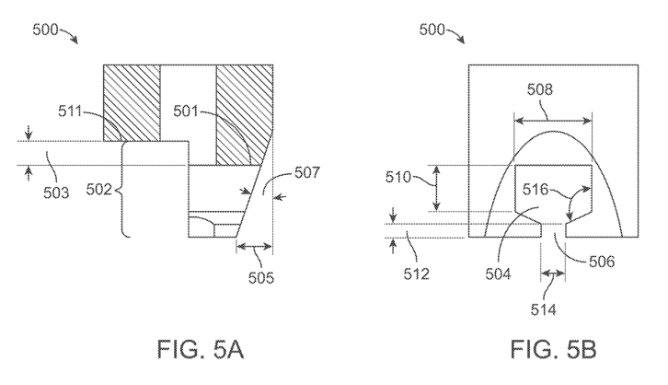
Close-Up Views of Cannula
Top of Aperture
Aperture width
(~0.069m)
Higher than top of aperture – mitigate risk of lead clipping on the rear wall of the cannula
Top of Indentation
Aperture height
(2/3 of aperture width, ~0.04m)
Indentation
(facilitate cleaning, improve visibility of cameras)
Slot
Slot height
(1/4 aperture height, 0.011m)
Aperture
Slot width
(2x slot height, 0.022m)
Side View
Front View

Slide 9
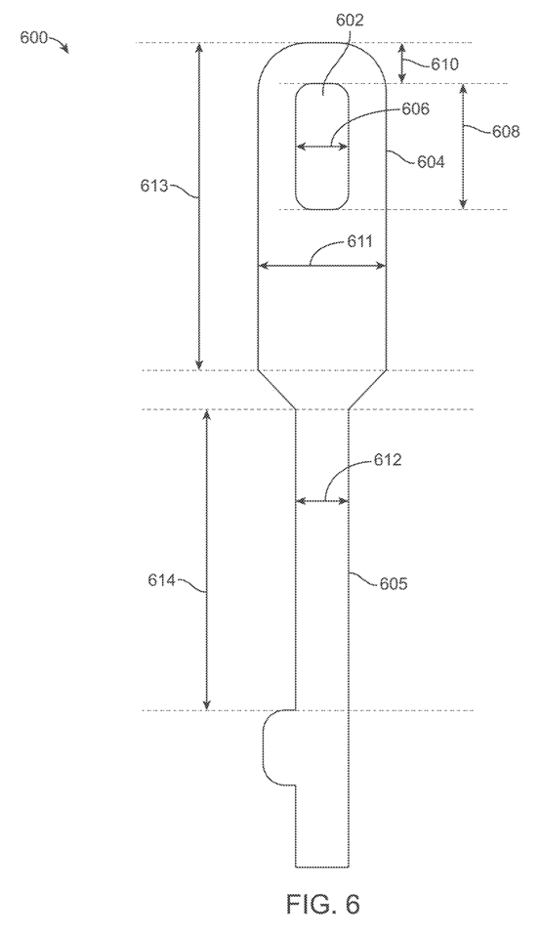

Lead with Expanded Region
Opening
Expanded region height
(~5-6x needle width, ~3-4x opening height)
Expanded region
Expanded region width
(~1.5-5x 2nd region width, ~1.1-1.5x needle width, to prevent premature exit of cannula during seating of lead)
2nd region width
2nd region

Slide 10
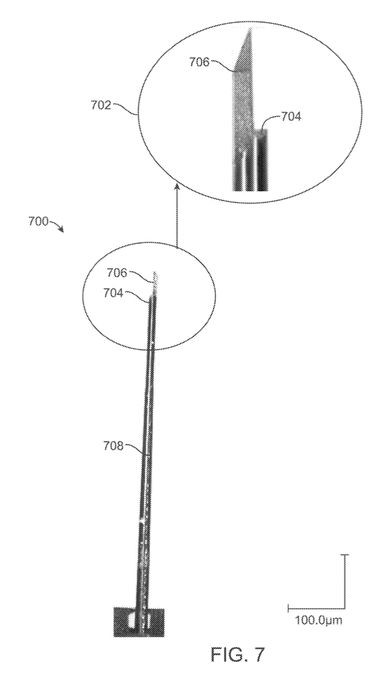
Needle with Ledge
1st portion
Ledge
2nd portion

Slide 11
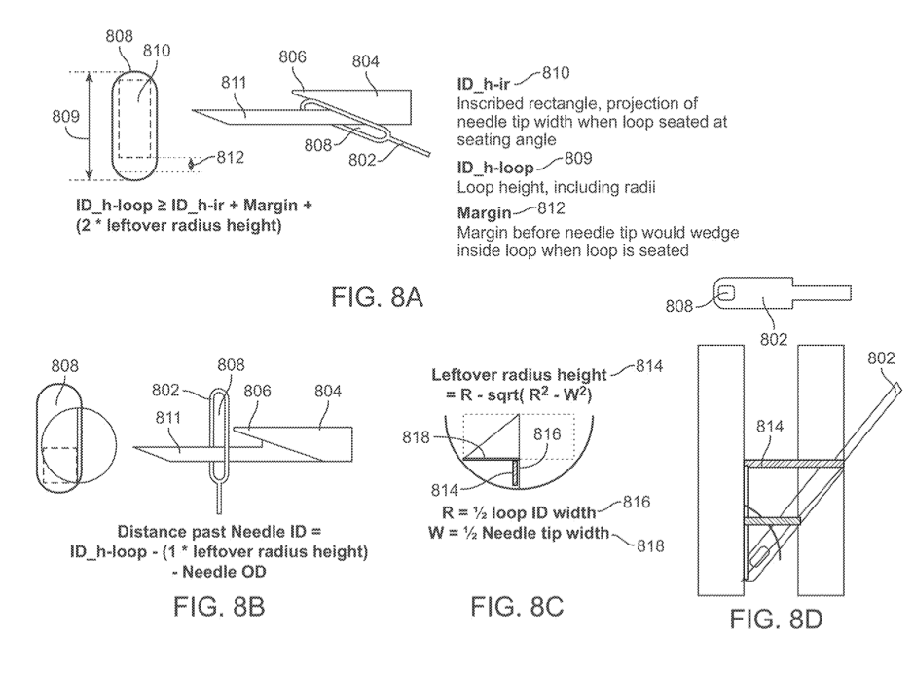
Close-Up View of Lead and Needle
Opening
ID_h-ir
Tip of needle
Ledge
Needle
ID_h-loop
Margin
Opening
Lead

Slide 12
Close-Up View of Lead and Needle

Slide 13
Example Geometry of Lead and Needle

Slide 14

Close-Up View of Lead and Needle
Leftover radius height
Seating angle

Slide 15
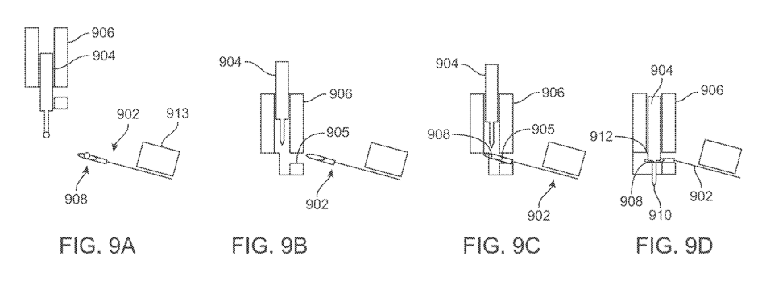
Needle, Lead and Cannula
Cannula
Needle
Needle
Temporary attachment surface
Cannula
Lead
Exit gate aperture
Ledge
Opening
Lead
Tip
Before Engagement
Towards Engagement Position
Towards Engagement Position
During Engagement with Lead

Slide 16
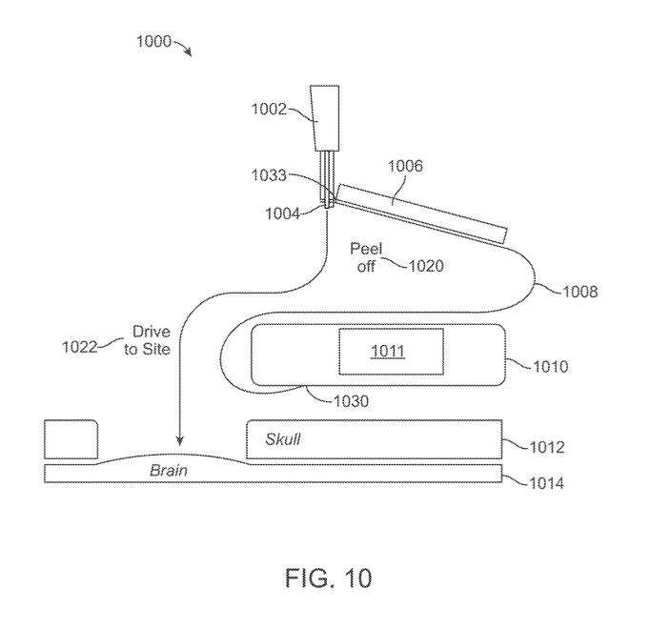
Lead Engaged with Needle and Cannula
1. Dispose lead on a temporary attachment surface
Cannula
Temporary attachment surface
(flexible backing made of silicon or parylene)
2nd end of lead
(left implanted in brain)
Needle
2. Peel lead off temporary attachment surface
Lead
3. Drive lead to implantation side
Antenna
Circuitry assembly
Include storage package structure with circuitry
Remains in-vivo of subject
Cranium
1st end of lead
(disposed in circuitry assembly)
Brain

Slide 17
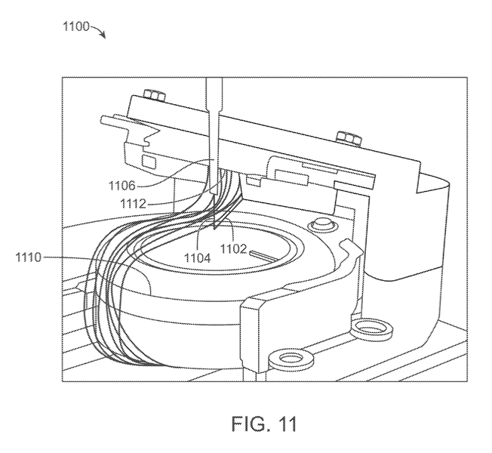

Multiple Leads Disposed for Implantation
Cartridge
Temporary attachment surface
Circuitry assembly
Needle
Multiple leads

Slide 18
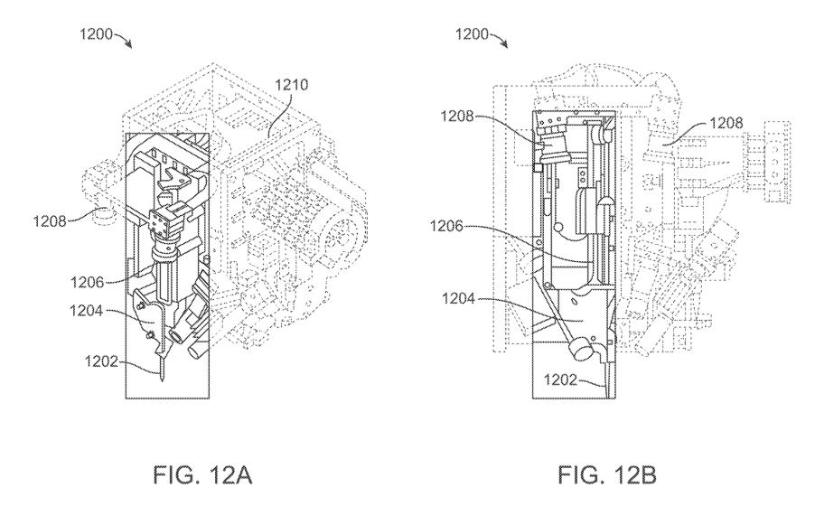
Apparatus for Implantation and Engagement of Lead
Microprocessor controller
Cameras
Cameras
Cameras
Robotic arm
Robotic arm
Cartridge
Cartridge
Needle
Needle

Slide 19
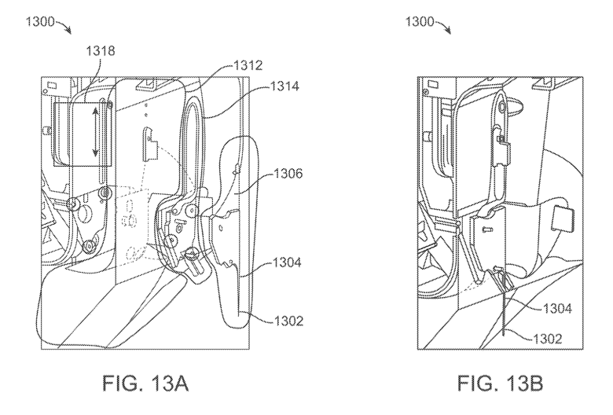
Close-Up View of Apparatus for Implantation and Engagement of Lead
Motor
Drape / cloth
(sterile, replaceable)
Kinematic coupler
(redirect imaging path from cameras, sterile mounting for needle + cartridge)
Robotic arm
Cartridge
Cartridge
Needle
Needle

Slide 20
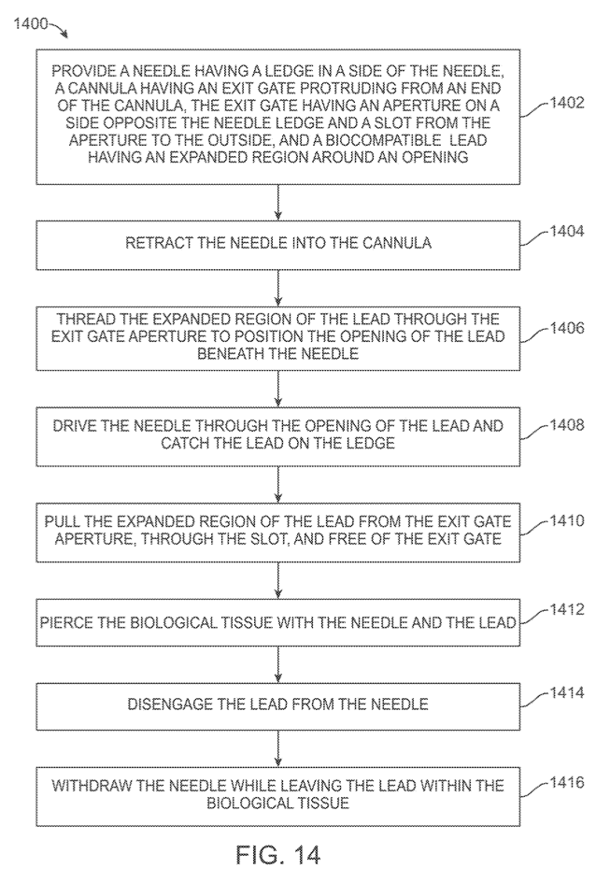
Flowchart for Engagement & Implantation of Lead

Slide 21

Step 1:

Slide 22

Step 2:

Slide 23
Step 3:

Slide 24
Step 4:

Slide 25
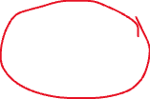
Step 5:

Slide 26


Step 6:
Brain

Slide 27

Step 7:
Brain

Slide 28
Step 8:
Brain

Slide 29
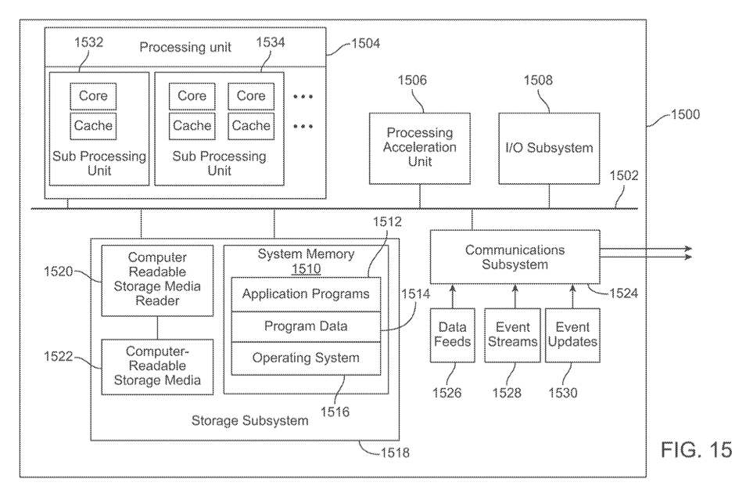
Computer System

